Slide 1

DO in the Jordan River
Matt Chaney, Manjot Kaur, Brittany Van Grouw
Water Resources Planning
April 28, 2016

Slide 2
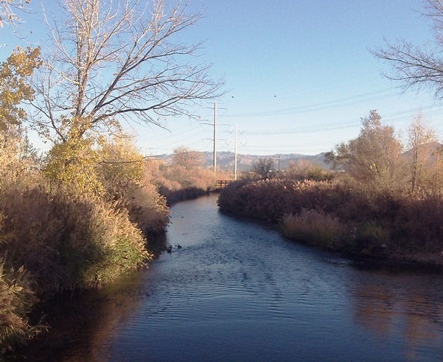
Outline
Stakeholder
Problem
Background
Data Requirements
Data Collection
WEAP Model
Results
Conclusion
Notes:
http://www.crockettclan.org/blog/?p=1046

Slide 3
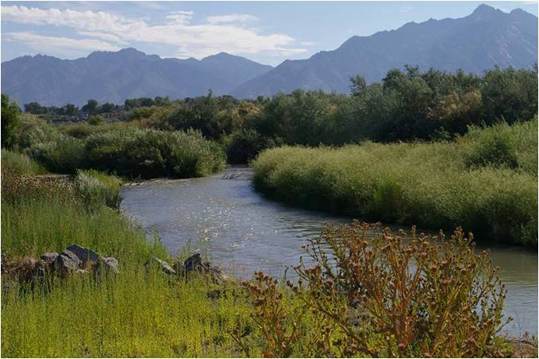

Stakeholder
Notes:
http://www.crockettclan.org/blog/?p=1046

Slide 4
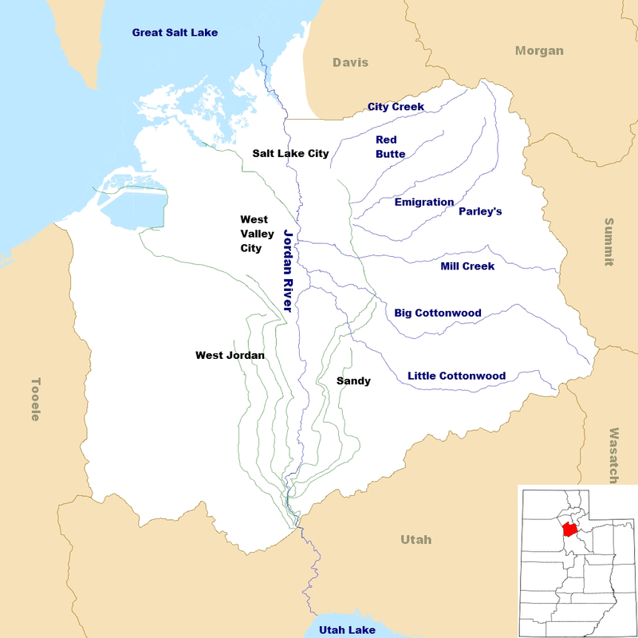
Problem Statement
Based on climate change scenarios, would changing the Wastewater Treatment Plant BOD effluent standards have a significant impact on DO levels in the Jordan River?

Slide 5
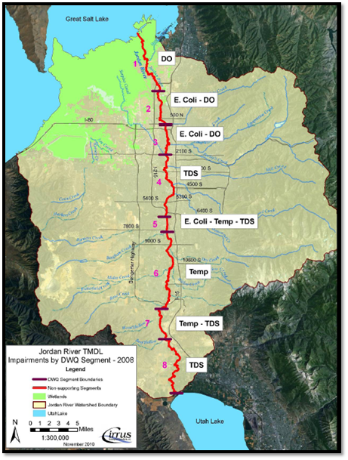
Background
Jordan River
Jordan River TMDL
DO in Jordan River

Slide 6
Data Requirements
Watershed Areas
Crop Coefficients
River Lengths
Flow-Depth-Width Curves
Historical BOD
Headflows
Projected Climate Data
Precipitation
Air Temp
Wind Speed
Relative Humidity

Slide 7
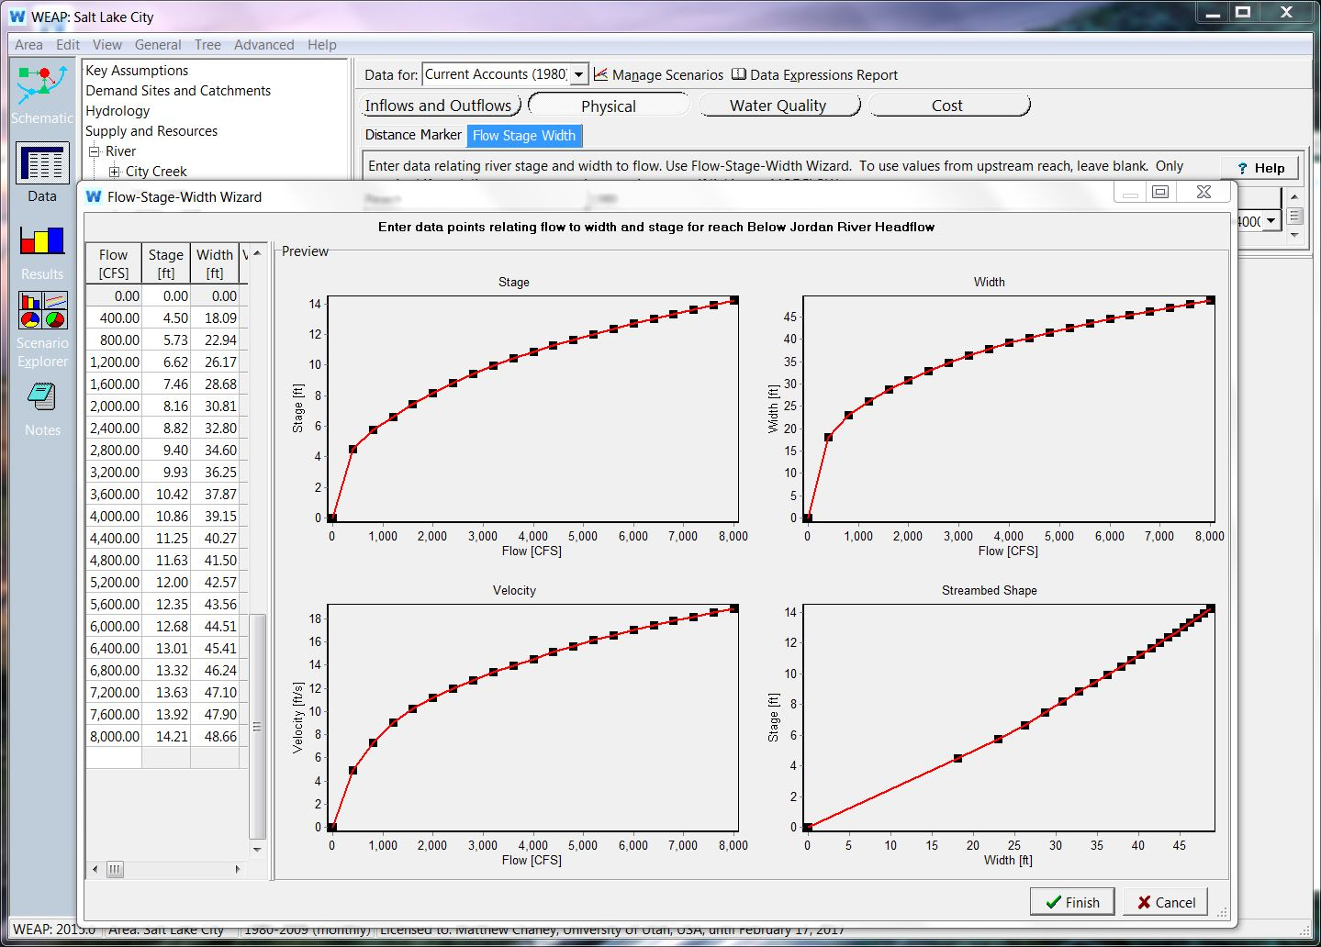
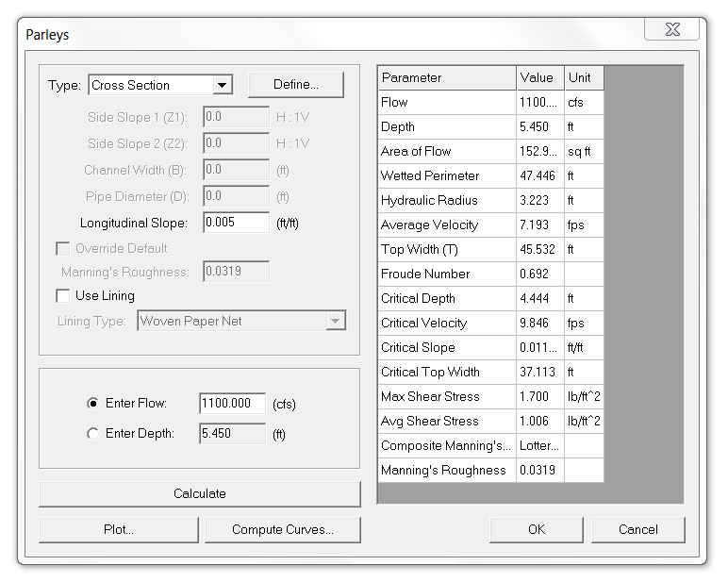

Flow-Depth-Width Curves
Data Collection

Slide 8
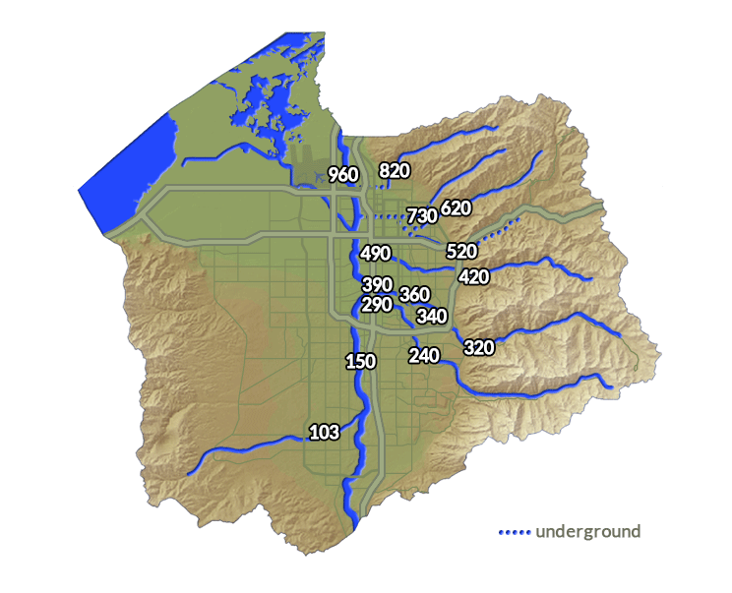

Flows
Data Collection
Notes:
Salt Lake County Flood Control
Average Monthly Flows

Slide 9
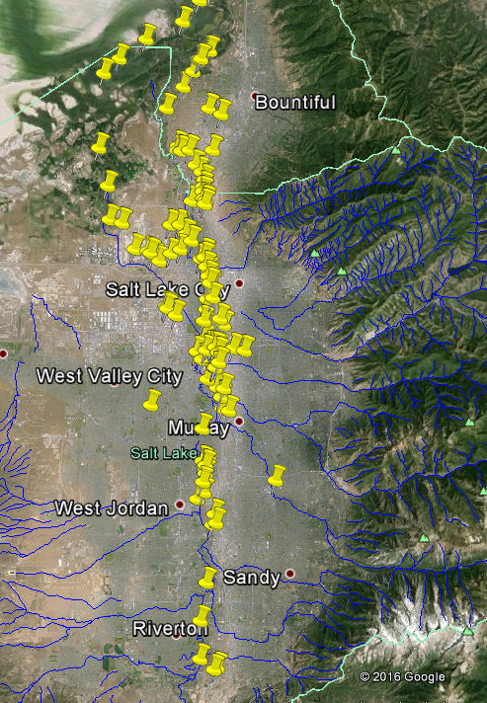

Historical BOD
Monthly Averages BOD (mg/L) for Mill Creek
January | 4 | July | 8
February | 5 | August | 5
March | 5 | September | 5
April | 5 | October | 5
May | 4 | November | 3
June | 7.5 | December | 3.25
Data Collection
 | City Creek | Mill Creek | Big Cottonwood | Jordan River
January | 2 | 4 | 2 | 3
February | 2 | 5 | 1 | 4
March | 3 | 5 | 3 | 4
April | 3 | 5 | 1 | 5
May | 3 | 4 | 2 | 2
June | 3.36 | 7.5 | 1 | 2
July | 4.15 | 8 | 2 | 3
August | 5.72 | 5 | 2 | 6
September | 4 | 5 | 1 | 4
October | 3 | 5 | 1 | 3
November | 2 | 3 | 3 | 2
December | 2 | 3.25 | 1 | 2
Notes:
R scripts created to sort through data
Google Earth Package to choose necessary sites
Scattered monthly data from [1950-2010]
Took monthly averages
Used for historical data reference for BOD

Slide 10
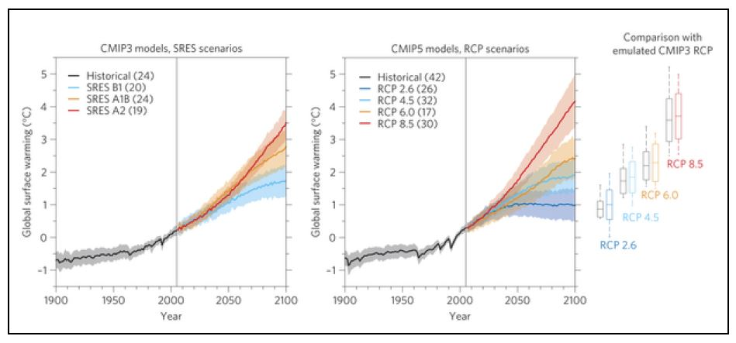

Projected Climate Data
Data Collection
Notes:
International Panel of Climate Change
RCP: Representative Concentration Pathways
2.6 – Peak and decline
8.5 – Steady increase
Precipitation, Air Temp, Wind Speed, Relative Humidity
“Downscaled CMIP3 and CMIP5 Climate and Hydrologic Projections”

Slide 11
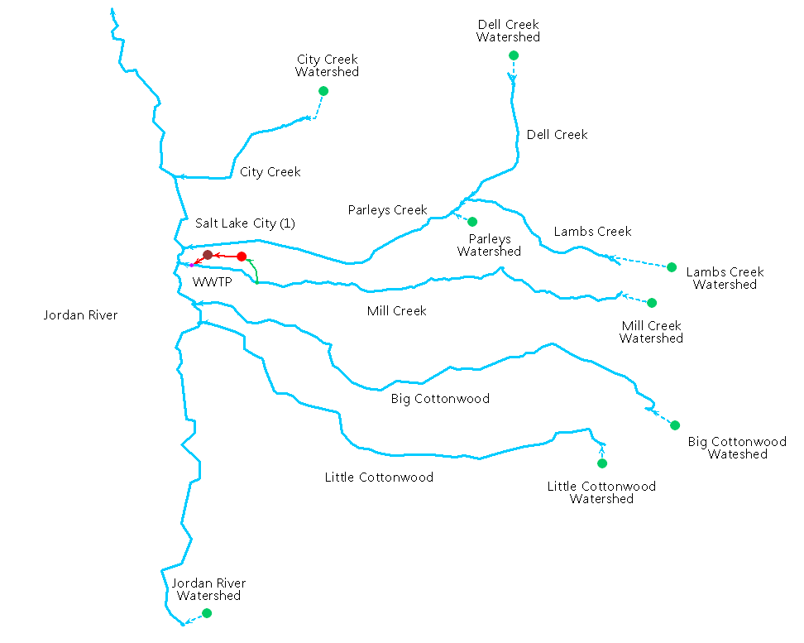
Schematic
Model
Notes:
8 Watersheds , 8 Streams, 1 Demand Node, 1 WWTP
Water “flows” through demand, assuming optimal WWTP, treats all the water coming from Mill Creek
Not possible for Mill creek to satisfy the demand of SLC, but simplify simulation of model assuming all demand will be met with the “reservoirs” that are not modeled
Focus is on the Central Valley WWTP and its effects on the Jordan River until 2099 in two different climate scenarios
Suggesting outflow BOD concentrations that will aid in the lowering of the BOD in the Jordan River

Slide 12
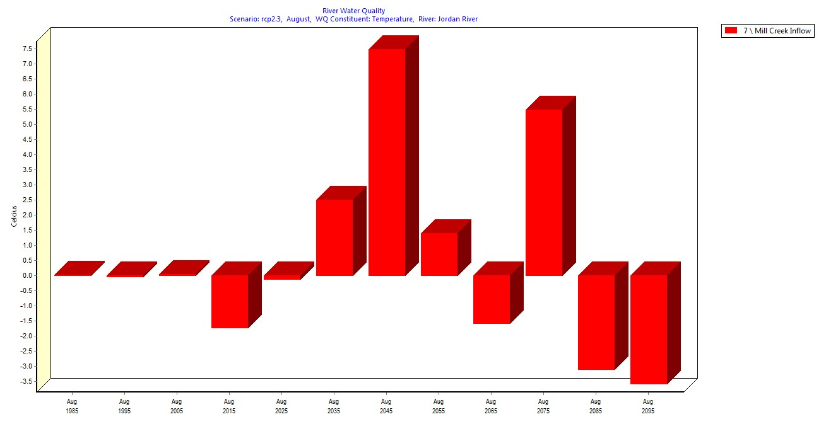
Results

Slide 13
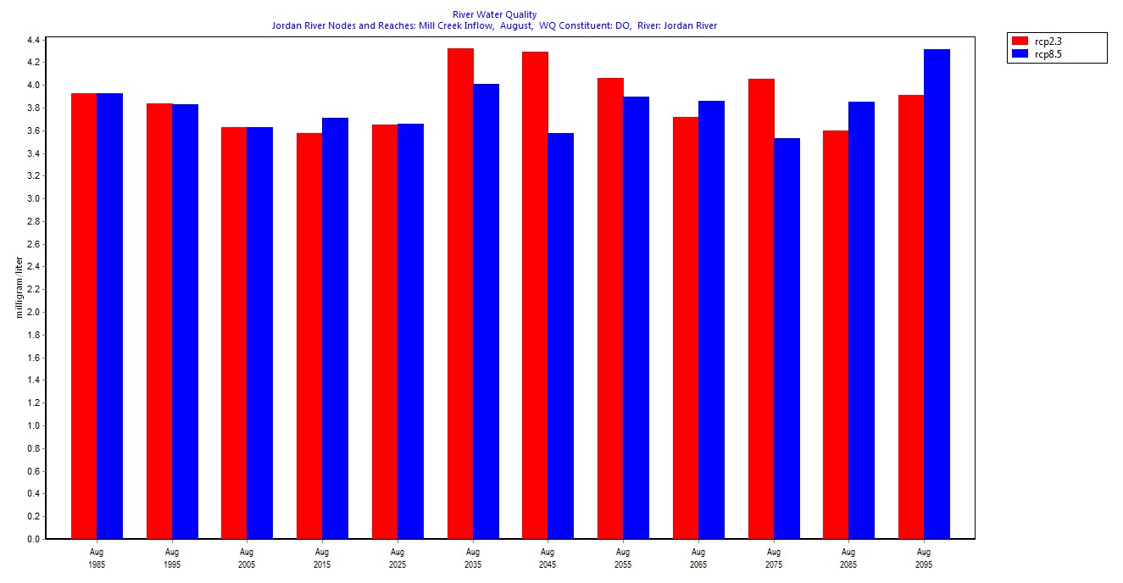
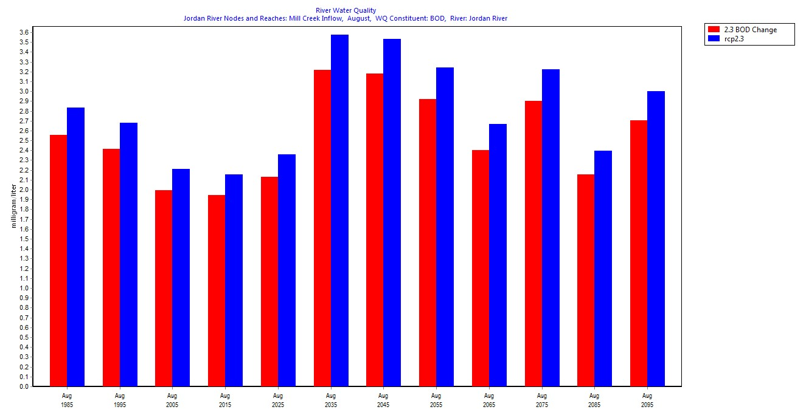
Results
Notes:
Change of BOD doesn’t necessarily cause change in DO

Slide 14
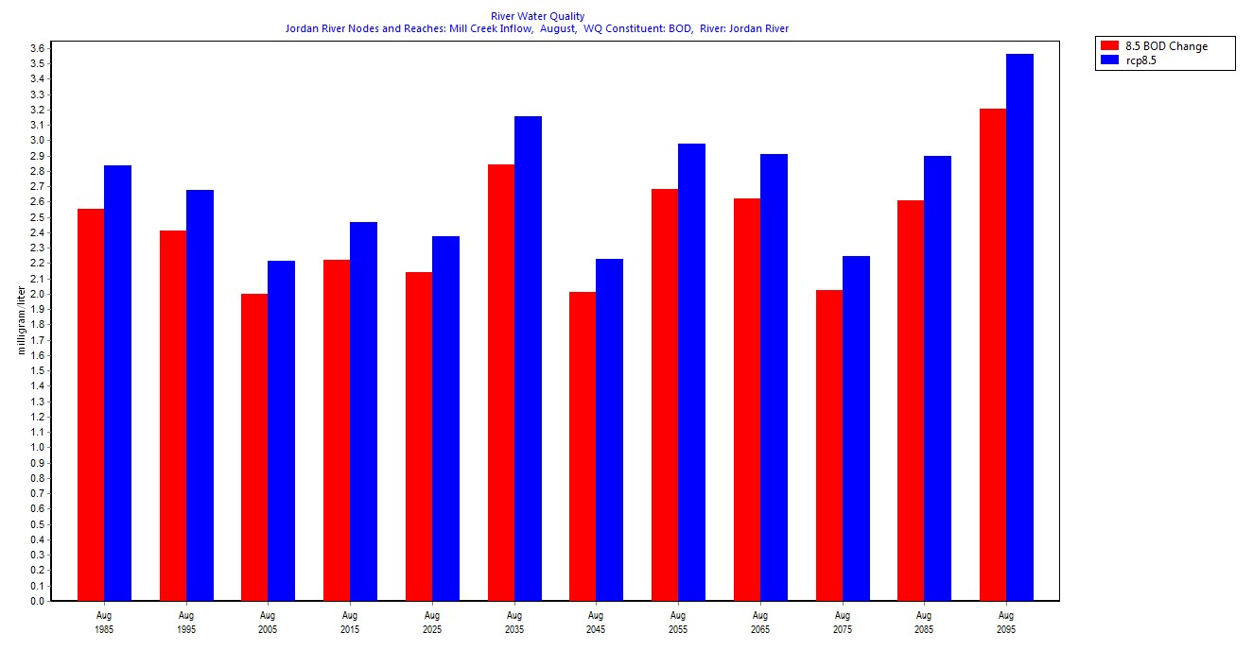
Results
Notes:
BOD

Slide 15
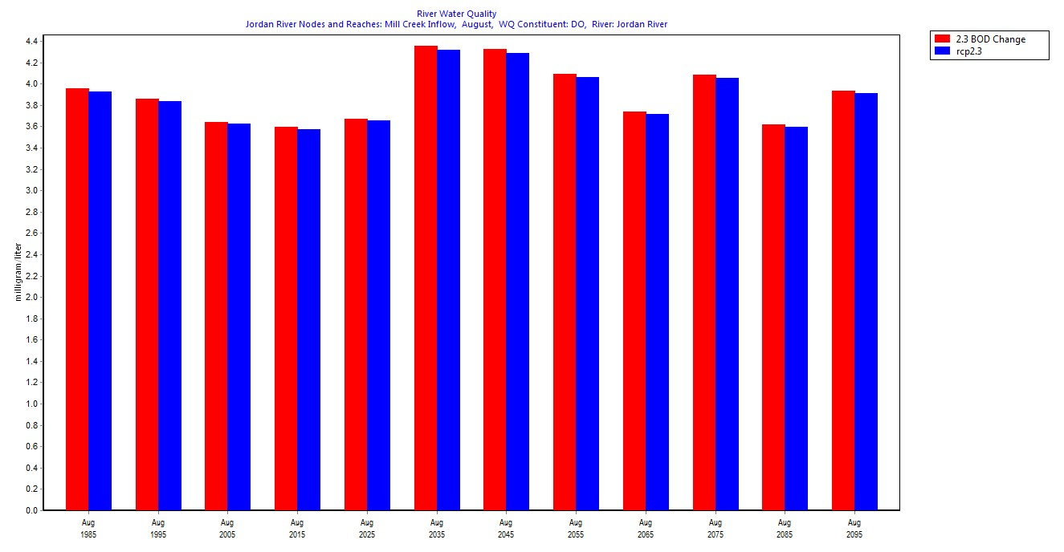
Results
Notes:
DO

Slide 16
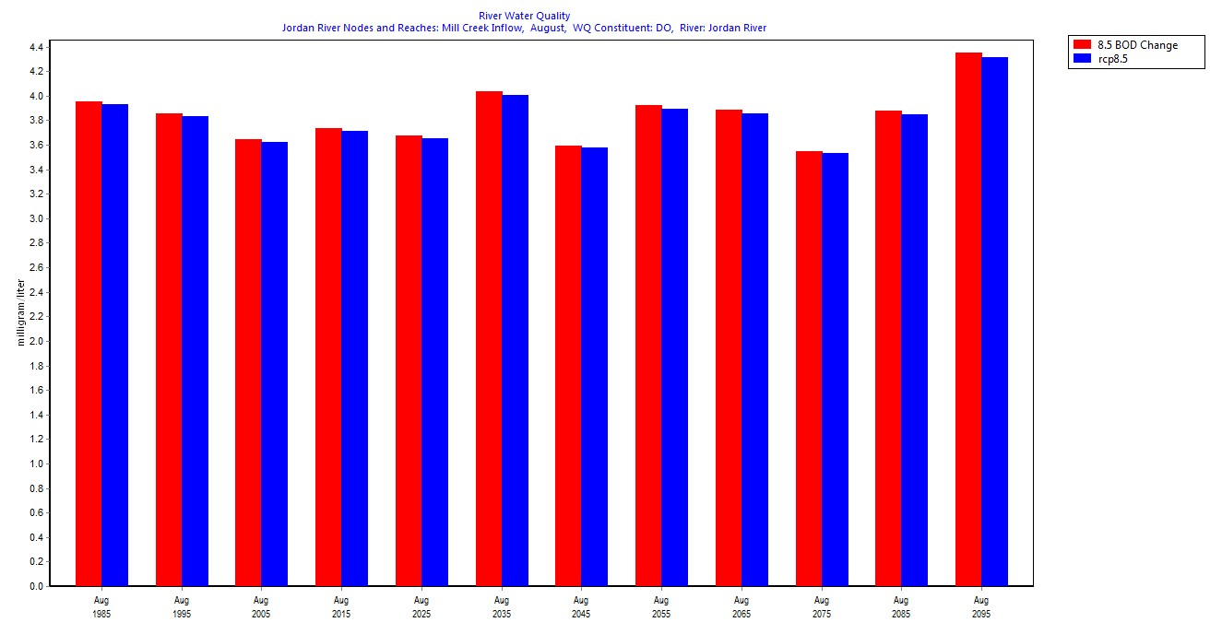
Results
Notes:
DO

Slide 17
Results
Notes:
DO

Slide 18
Conclusion
Problem Statement: Based on climate change scenarios, would changing the BOD effluent standards of Central Valley have a significant impact on DO levels in the Jordan River?
Conclusion: No - Changing the BOD effluent standard for Central Valley does not have a significant impact compared to the impact of climate change on DO
Future Work: Model can be expanded further to include impact from all point and non-point sources
Population growth/demand changes
Notes:
Conclusions (10)
Effectively restates the thesis
Main findings
And content covered

Slide 19
References
Ambient Water Quality Monitoring System (AWQMS) User Guide. N.p.: Goldsystems, 18 June 2013. PDF.
Goharian, Erfan, Class 24: Create a WEAP Model. University of Utah. December 1, 2015.
Jordan River Total Maximum Daily Load Water Quality Study - Phase 1. Logan, Utah: Cirrus Ecological Solutions, LC, 5 June 2013. PDF.
Salt Lake City County. "Blueprint Jordan River." Blueprint Jordan River. Salt Lake City County, Dec. 2008. Web. 01 Mar. 2016. <http://www.slco.org/blueprint/>.
Salt Lake City County. "Watershed Planning and Restoration Program." Water Quality. Salt Lake City County, n.d. Web. 01 Mar. 2016. <http://slco.org/watershed/wtrQual/wqBenificial.html>.
Sieber, Jack, and David Purkey. Water Evaluation And Planning System User Guide. Somerville, MA: Stockholm Environment Institute, U.S. Center, Aug. 2015. PDF.
Images:
http://gdo-dcp.ucllnl.org/downscaled_cmip_projections/dcpInterface.html
http://udottraffic.utah.gov/
https://slco.org/flood-control/real-time-streamflow-totals/
https://awqms.utah.gov/HelpAbout.aspx
Notes:
Have [#] next to each image - add next to reference

Slide 20

Questions?

